Slide 1

WorldVisitz Mobile Application Agile Delivery Launch
Agile Onboarding - Presentation for the Agile Team
Presented by: Mohammad Khallaf
© 2019 Udacity. All rights reserved.

Slide 2
Topics
Agile benefits
Information radiators
Ceremony schedule
Team composition
Appendix

Slide 3
Agile Benefits
Customer feedback is received late, in market testing and after product launch
In Agile manifesto Our highest priority is to satisfy the customer through early and continuous delivery of valuable software

Slide 4
Agile Benefits
Agile methodologies emphasize regular communication through daily stand-up meetings, sprint planning, and retrospective meetings. These meetings provide opportunities for team members to interact, share updates, and discuss any challenges they may be facing. This frequent interaction can help build stronger relationships and improve team cohesion.
The team lacks close physical and spiritual cohesion.

Slide 5
Agile Benefits
Instead of planning everything upfront, Agile emphasizes iterative planning. Teams initially identify high-level requirements and goals but then break down the work into smaller, more manageable chunks that can be planned in detail for shorter timeframes, such as sprints in Scrum or cycles in Kanban.
Requirements and product planning are traditionally done in advance.

Slide 6
Information radiators
“Information radiator” is the generic term for any of a number of handwritten, drawn, printed, or electronic displays that a team places in a highly visible location, so that all team members, as well as passers-by, can see the latest information at a glance: count of automated tests, velocity, incident reports, continuous integration status, and so on.
Also Known As
a related term, nearly synonymous, is “Big Visible Chart”
more generally, one speaks of “informative workspaces“

Slide 7
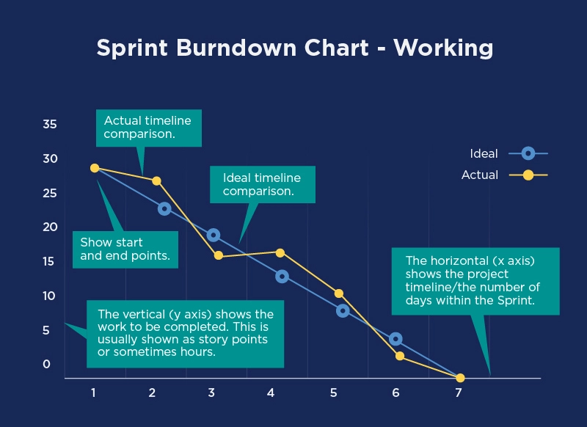
Burndown Chart

Slide 8
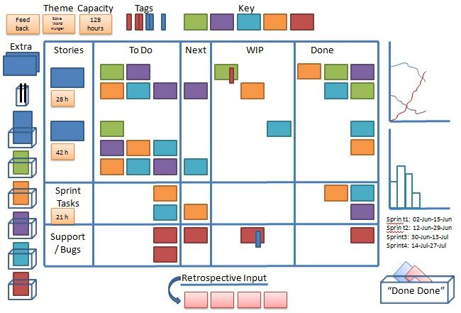
Project status

Slide 9
Team composition
Product Owner
Scrum Master
Team members
The PO represents the business and helps translate customer requirements into work packages for the development team.
The SM oversees the development process and facilitates improvements to it.
Scrum is all about Team members working autonomously to contribute to the outcome

Slide 10
In any project, clarifying roles and responsibilities among team members and stakeholders is crucial for effective collaboration and clear accountability. In the Scrum framework, there are three key roles: Product Owner (PO), Scrum Master (SM), and Team Members. Product Owner (PO): The Product Owner, in our case John Smith, plays a pivotal role in understanding customer requirements and translating them into actionable work items for the team. Leveraging his extensive market research and product knowledge, John will ensure that the team focuses on delivering value to customers. By closely collaborating with the team and being physically present in the same office, John will foster synergy and facilitate faster and more fluid communication, thereby enhancing the efficiency of the development process.

Slide 11
Scrum Master (SM): The Scrum Master, for Worldvisitz, will be Jane Doe. In addition to facilitating effective communication within the team, the Scrum Master ensures that team members have everything they need to perform their roles effectively. Jane's role as a good communicator and her ongoing interaction with team members positions her well to identify and address any impediments that may hinder the team's progress. Jane will play a crucial role in fostering collaboration, problem-solving, and continuous improvement within the team, ultimately contributing to its success. Team Members: The rest of the employees are the team members, who form the core execution force of the project. As the pulsating heart of the project, each team member's contribution is vital to achieving project objectives. With clear guidance from the Product Owner and support from the Scrum Master, team members are empowered to collaborate, innovate, and deliver high-quality results.

Slide 12
Scrum Master (SM): The Scrum Master, for Worldvisitz, will be Jane Doe. In addition to facilitating effective communication within the team, the Scrum Master ensures that team members have everything they need to perform their roles effectively. Jane's role as a good communicator and her ongoing interaction with team members positions her well to identify and address any impediments that may hinder the team's progress. Jane will play a crucial role in fostering collaboration, problem-solving, and continuous improvement within the team, ultimately contributing to its success. Team Members: The rest of the employees are the team members, who form the core execution force of the project. As the pulsating heart of the project, each team member's contribution is vital to achieving project objectives. With clear guidance from the Product Owner and support from the Scrum Master, team members are empowered to collaborate, innovate, and deliver high-quality results.

Slide 13
In summary, by defining and understanding the roles and responsibilities of each team member, we create a framework for effective collaboration, communication, and success in our project endeavors. Together, let's harness our collective strengths and make this project a resounding success. Good luck, and let's enjoy the journey ahead!

Slide 14
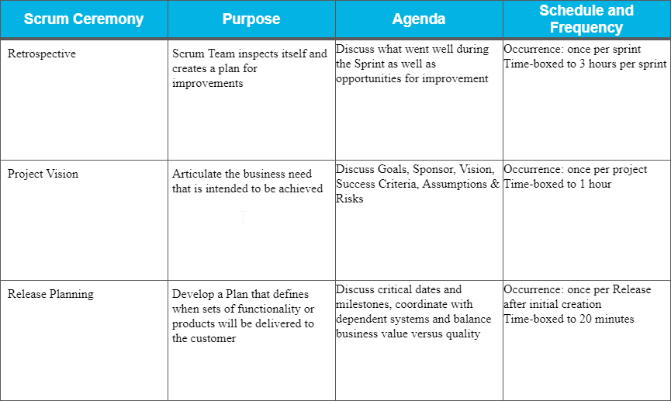
Ceremony schedule
I propose implementing the Scrum methodology for WorldVisitz, and I'd like to introduce you to a Scrum Ceremony Schedule to support our Agile transformation. These ceremonies are structured meetings with precise objectives, participants, and timeframes. They are indispensable components of the Scrum framework, as they provide essential opportunities for collaboration and progress tracking. Altering or removing any of these ceremonies significantly undermines the effectiveness of Scrum practices. It's imperative to adhere to these ceremonies faithfully to ensure the successful implementation of Scrum within our organization.

Slide 15
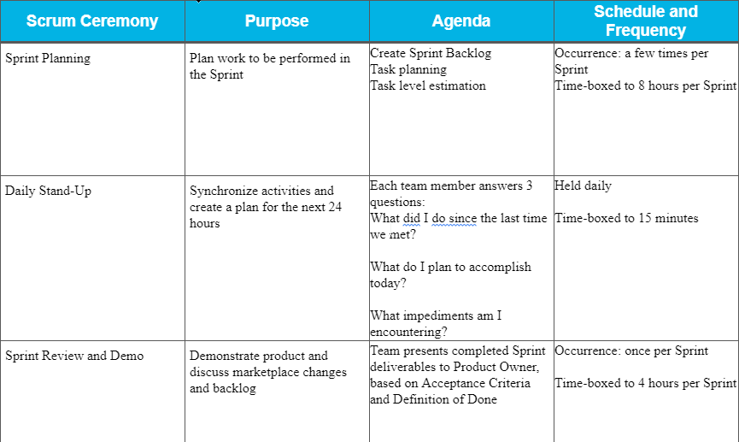
Ceremony schedule

Slide 16
Appendix
Jane Doe, the Project Manager, demonstrates strong communication skills, yet she tends to independently plan and allocate work based on personal preferences, hindering the autonomy and effectiveness of SCRUM Planning for the team. To facilitate her transition to Agile practices without direct disruption, I've decided to assign her the role of Scrum Master. This allows her to leverage her communication abilities while learning the new Agile approach. This transition not only simplifies her adaptation to Agile but also ensures the team benefits from having a skilled communicator in the Scrum Master role.
John Smith, the Product Manager, excels in conducting thorough market research and product planning, valuable traits for a Product Owner. However, he tends to become detached from developers due to procedural, departmental, and geographical boundaries. To address this issue promptly, I propose keeping all onshore team members in close proximity whenever feasible. Additionally, involving offshore developers in all ceremonies and providing suitable audio/video conferencing facilities can bridge the physical gap. While virtual collaboration is viable, physical proximity fosters camaraderie, teamwork, and synergy, enhancing overall productivity.
The offshore developers, including Jim Brady, Nathan Connor, Venkat Ragu, and Ali Khan, are contractors with advanced technical expertise. Historically, the Project Manager assigned complex project deliverables individually. However, we've rectified this by redistributing roles. Each team member should now have the freedom to select tasks collaboratively, promoting growth, responsibility, and cooperation. This shift not only fosters a consistent coding standard but also facilitates knowledge transfer and enhances team cohesion.

Slide 17
Appendix
Kathy Qualls, the Tester, typically enters the process lifecycle post-code development, which is deemed late for effective testing within a Scrum framework. To address this, individuals like Kathy and other developers should familiarize themselves with Continuous Integration/Continuous Deployment (CI/CD) principles. This allows for automated testing and deployability of code at any given time. Additionally, Kathy's feedback should be shared with the entire team, rather than solely with the Project Manager, facilitating a more inclusive and efficient feedback loop.
Jerry Holden, the Business Analyst, possesses the necessary skills for product definition and business analysis. However, he may benefit from personalized Agile coaching to understand the value of embracing changing requirements and iterative project development. While adherence to a precise project plan is important, prioritizing responsiveness to change aligns with Agile principles and customer satisfaction.
James Cowx, the UX Designer, traditionally develops UX based on specifications outlined in the Project Plan, receiving customer feedback late in the process. With changes in Project Manager and Business Analyst roles, James's workflow will naturally evolve. Adopting a fail-fast approach is crucial, ensuring prompt and continuous customer feedback integration to expedite product enhancements and customer satisfaction.
Holly Vogt, the Subject Matter Expert, provides valuable expertise that shouldn't be isolated from the team. Integrating her feedback into Scrum ceremonies promotes fluid communication and daily feedback exchange, benefiting the entire team. Addressing any preference for one-on-one interactions through personalized coaching can enhance collaboration and ensure effective knowledge sharing within the team.

